Slide 1
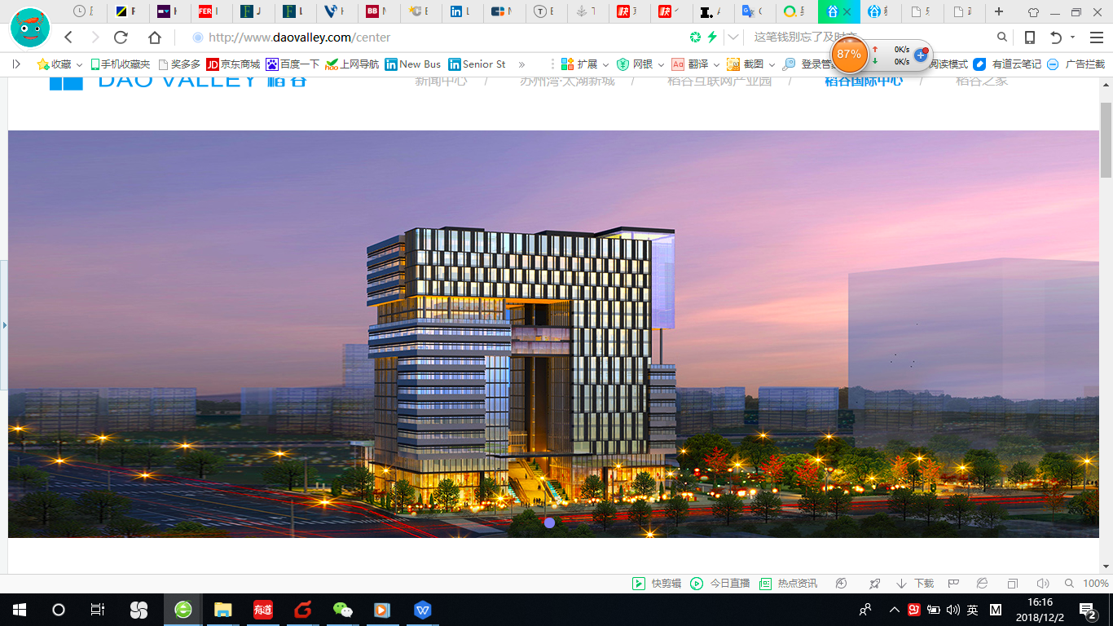

将北欧与高端医疗生态系统导入中国
NHC BioTech Center
May 2020
Business Plan

Slide 2
Contents
Summary
NHC BioTech Center: Roadmap
NHC BioTech Center: Core products and services
Nutrition health and medical application lab
Laboratory project promotion
Big Data
Medical Center: AI-assisted immune cell therapy against cancer!
Our office allocation and future needs
The profit model of incubator
Finacial forecast
Fund raising
Exit strategy
Our partners
Our partners and customers (part)
Marketing events in 2018-2020
Founder and CEO's profile
Advisors (part)
Contact us

Slide 3
1.Summary
Market background | The Chinese people have the affluence and correspondingly growing demand for BioTech food and medicare products and services. we believe that BioTech programs from advanced nations such as Finland, the US and Singapore have a big potential in China, particularly when they are adapted to the Chinese market.
Introducing BioTech programs from Finland, the US and Singapore to China and localize it to meet the needs of the Chinese people.
Our mission
About us | We strive to bring excellent BioTech resources overseas into China as the Chinese people are trading up to more premium products and services. We have the most experienced teaching faculty and mentors from the world's leading research and teaching institutions. We organize Chinese companies to go to the US and Finland to inspect advanced local BioTech innovative networks and systems,make on-site visits to advanced BioTech companies, and thus improve their overall business knowhow and management standards. We also operate an incubator with both office space and labs to share among startups working on various aspects of alternative protein.

Slide 4
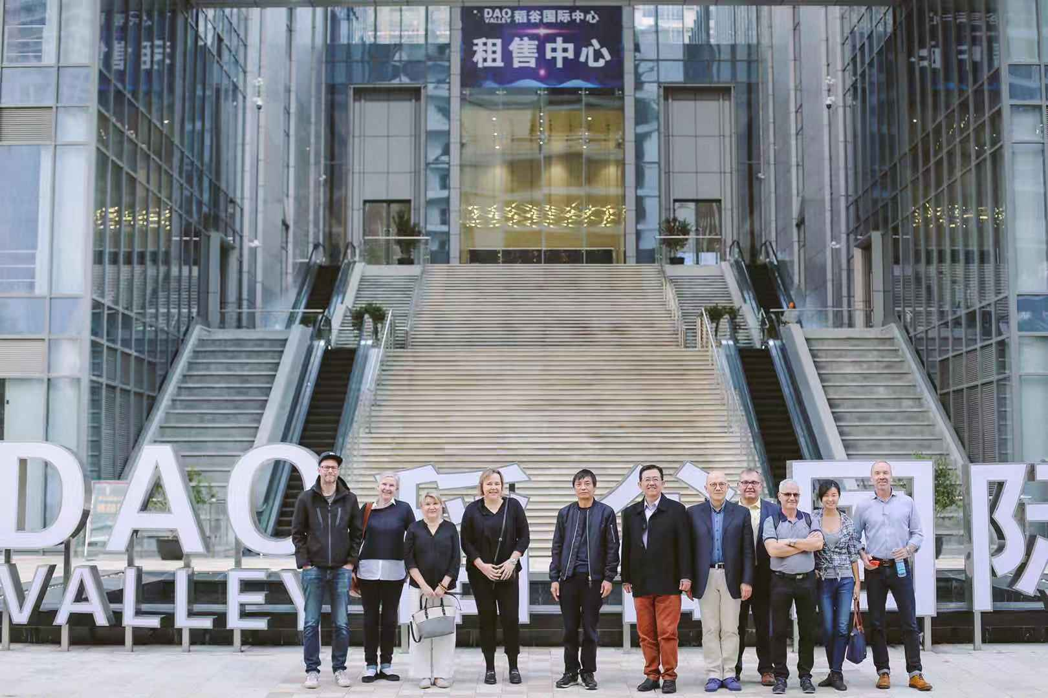
2.NHC BioTech Center: Our roadmap
Today
2020-2021
2022 and beyond
Join hands with Tee Yih Jia Food on international trade to import Brazilian Beef into China
Our nutrition health and medical application lab in China provides following services to Chinese customers：
Stem cell depot
Immunocyte and NK cell for cancer expansion Lab
Growth Factor Anti-Aging R&D facilities
An incubator with laboratories and office space focusing on alternative protein and health food
NHC BioTech Center as industry standard in BioTech：
Alternative protein lab
AI, Bigdata for NHC Biotech center
NHC BioTech posing with the Finnish partners

Slide 5
3.NHC BioTech Center： Core products and services
Stem cell depot
Immunocyte and NK cell for cancer expansion Lab
Alternative Protein and Health Products R&D facilities
Growth Factor Anti-Aging R&D facilities
Nutrition health and medical application lab

Slide 6
4.Nutrition health and medical application lab
Platform introduction
1.Components: Natural product purification and application platform
R&D and application platform of genetic engineering
Development and application platform of cell and fermentation engineering
Immunology R&D and application platform
2.Application direction: Development of new resource food
Biomedical development
Biomedical diagnostic development
3.Product direction:
3.1 New resource food: new resource protein food, special medical nutrition factor food, etc
3.2 Biomedical development: coagulation factors, targeted biomedicine, etc
3.3 Biomedical diagnostic development: POCT, precision medical diagnosis products and intelligent medical treatment,
etc

Slide 7
5.Laboratory project promotion
1 New resource food：
1.1 Alternative protein
1.2 Nutritious food of sialic acid
1.3 Nutritious food of neuric acid
2 Biomedical development:
2.1 Natural products of coagulation factors
2.2 Genetic engineering vaccine
2.3 Targeted tumor drugs
3 Biomedical diagnostic development:
3.1 Chemiluminescence POCT: Diagnosis of tumor markers,
cardiovascular risk, infectious diseases, etc.
3.2 Precision medical diagnosis: Molecular diagnosis and genetic accurate medical diagnosis of infectious diseases
3.3 Intelligent medical: POCT combined with AI manufacturing

Slide 8


6.Big Data-Big Business
The purpose of Finland's big data project (2017-2019) is to find market opportunities through the collection and analysis of big data in the B2B market, and then establish relevant entrepreneurial projects in a targeted manner.
The implementation of this project relies on a multidisciplinary team: big data researchers, marketing and innovation talent, quantity and quantitative analysts, empirical analysts, and more.
Project Beneifts /output：
This project will improve the level of big data application analysis and help entrepreneurs find new business opportunities in the B2B market.
Help companies improve their sales strategy and sales
channels, save costs and improve efficiency.
Status: This project has been operating in Finland for two and a half years, and has about ten strategic partners from universities and research institutions in Finland, Belgium and Germany, and ample working capital. The investor is TEKES of Finland.

Slide 9


7.Medical Center: AI-assisted immune cell therapy against cancer!
The Singaporean Government has listed immune cell therapy as its top priority in health care in 2020. The country has amassed substantial experiences in this regard. So is the US, where cancer is commonly treated with immune cell therapy.
NHC Health has overseas hospital partners standing ready to embark on AI-assisted immune cell therapy in China.
NHC Health is in discussion with Suzhou No. 9 Hospital in launching a project to tackle cancer with artificial intelligence (AI) and immune cell therapy.

Slide 10
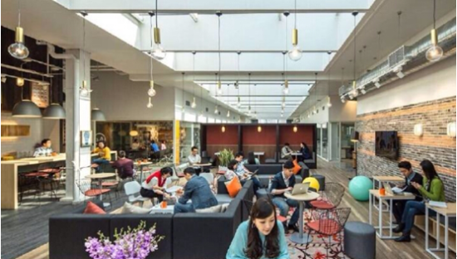
8.Our office allocation and future needs
Expecting exponential expansion of the operation, the Center will in the near future need 1000 sqm of office space, which be divided about evenly between ：
  NHC BioTech with its games and events management, IT and marketing
  Nutrition health and medical application lab
  Conference rooms of varied sizes, which includes a multi-functional center that is similiar in size and functions to the big lecturing halls of business schools.

Slide 11
9.The profit model of incubator
The profit model of incubator
  Technology development, technology transfer, clinical approval transfer transformation and financing development
  National project industry support
  Select high quality projects for production transformation

Slide 12
10.Financial forecast（Million yuan）
Project | 2021 | 2022 | 2023
International Trade: import Brazilian Beef | 10 | 20 | 40
Alternative protein laboratory sharing platform (incubator) | 2 | 10 | 20
Total sales | 6 | 30 | 60
PAT(2 0%) | 2.4 | 6 | 12
Cumulative PAT | 2.4 | 8.4 | 20.4

Slide 13

11.Fund raising
Investment | S$ 4M / RMB 20M
No. of investors | 40
Each Unit | S$100,000
Fund | BioTech Fund

Slide 14
12.Investment Stategy
Exit Stategy
3+2 years: 3 years' investment and a 2-year exit period
List the project as BioTech Project in Singapore
Sell the company at premium to a public health care company
List the company at the STIB (Shanghai Exchange's new Science and Technology Innovation Board)

Slide 15



13.Our partners
Haaga-Helia is a strongly business orientated university of applied sciences in Finland. Through education, research and development, it prepares professionals for business and services, putting emphasis on the principle of co-operation, entrepreneurship, innovation and internationality. In Finland Haaga-Helia operates an innovation centre with the support of Nokia and other major Finnish companies. Haaga-Helia plans to install its first overseas R&D Innovation center in China, ie., in NIIC in Suzhou.
Established in 1877, Regis University is consistently ranked as a Top Tier Western University by U.S. News & World Report. Regis stresses on the importance of critical thinking and having a global perspective in its pedagogy. Its university has renowned IT faculties and R&D backgrounds, and plan to play an active role in NIIC and have its Regis R&D Innovation Centre.
University of San Francisco offers 17 undergraduate and 9 postgraduate majors, and currently more than 8,000 students from 75 countries are studying here. The University of San Francisco is the representative of American professional development universities. Its undergraduate education is famous for its entrepreneurial spirit. It is known as the cradle of Chinese chairmen and has cultivated many well-known entrepreneurs such as theCEO of Intel Corporation and the founder of Adobe.

Slide 16
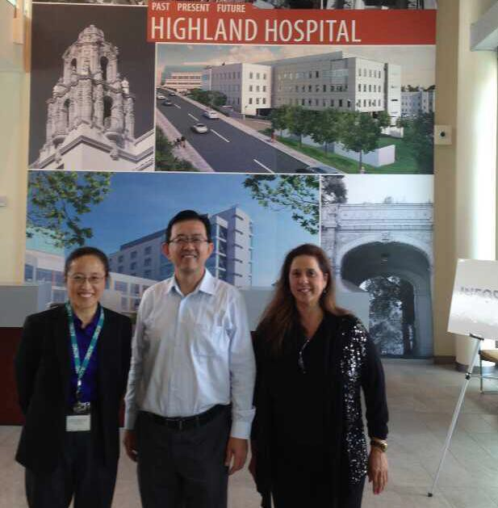

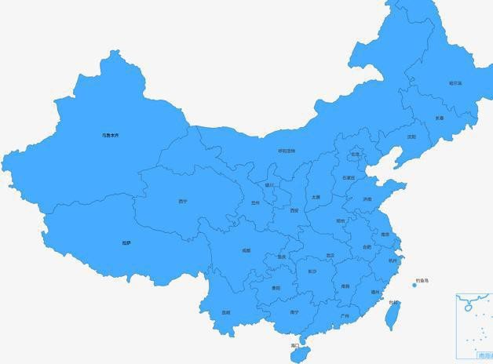
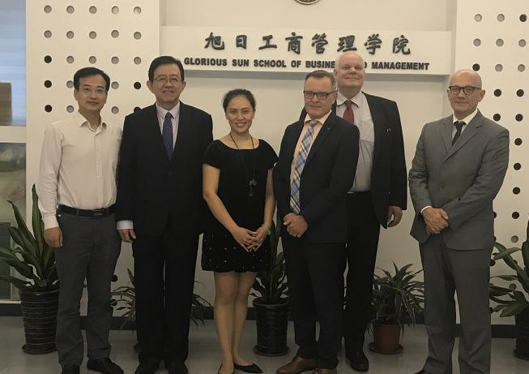


14.Our Partners and Customers
Suzhou Wujiang District Ministry of Health
Suzhou No.9 Hospital
Wuxi No.8 Hospital
Wuxi No.3 Hospital
Customer
Lan Zhou Military General Hospital
ents
Corporate customers
Longrich Group
WCI Investment Group
Nu Skin China
NHD China
Nivea China
Fed Express China
Overseas Hospital Partner
Academic Institution Partners
Singapore Mount Elizabeth Hospital
Haaga-Hela University of Applied Science
Regis University
Singapore Gleneagle Hospital
University of San Francisco

Slide 17
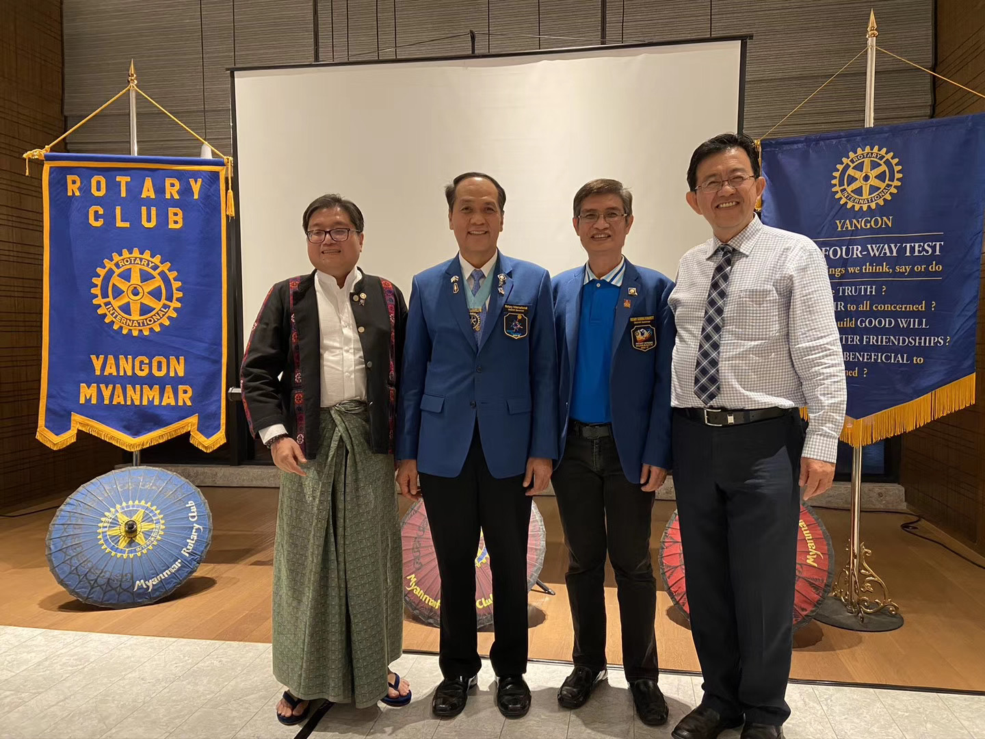
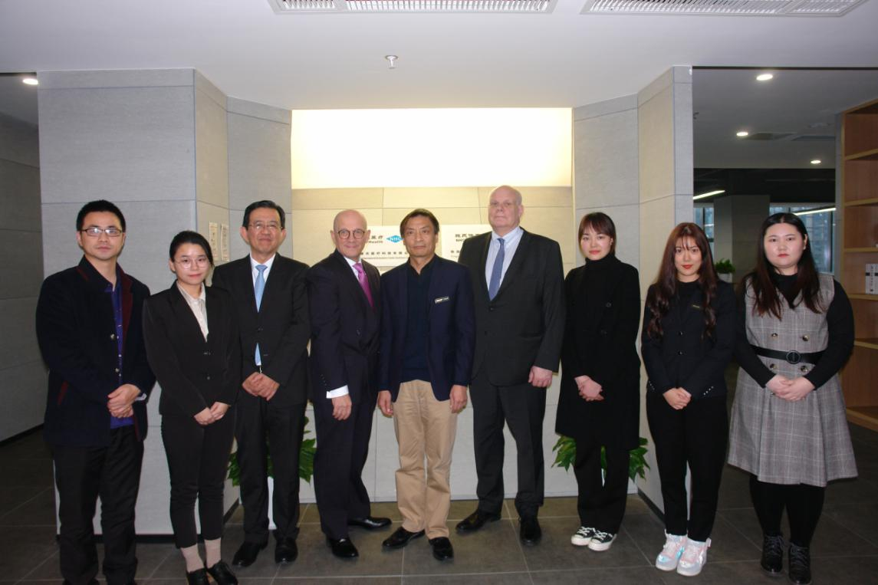
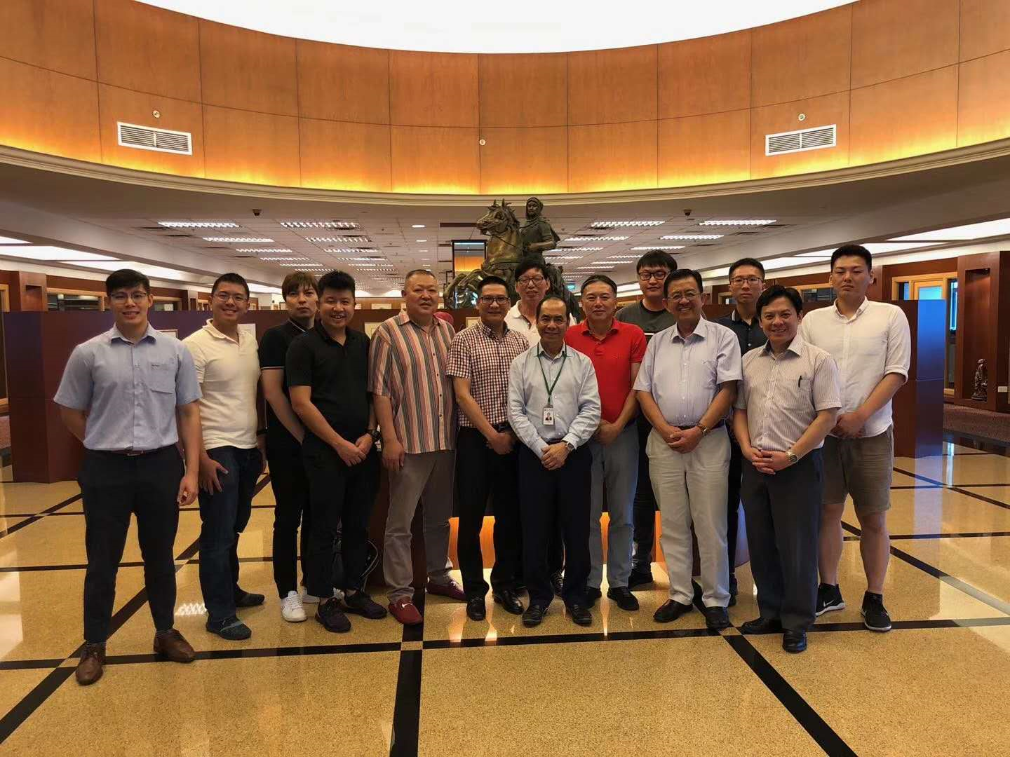
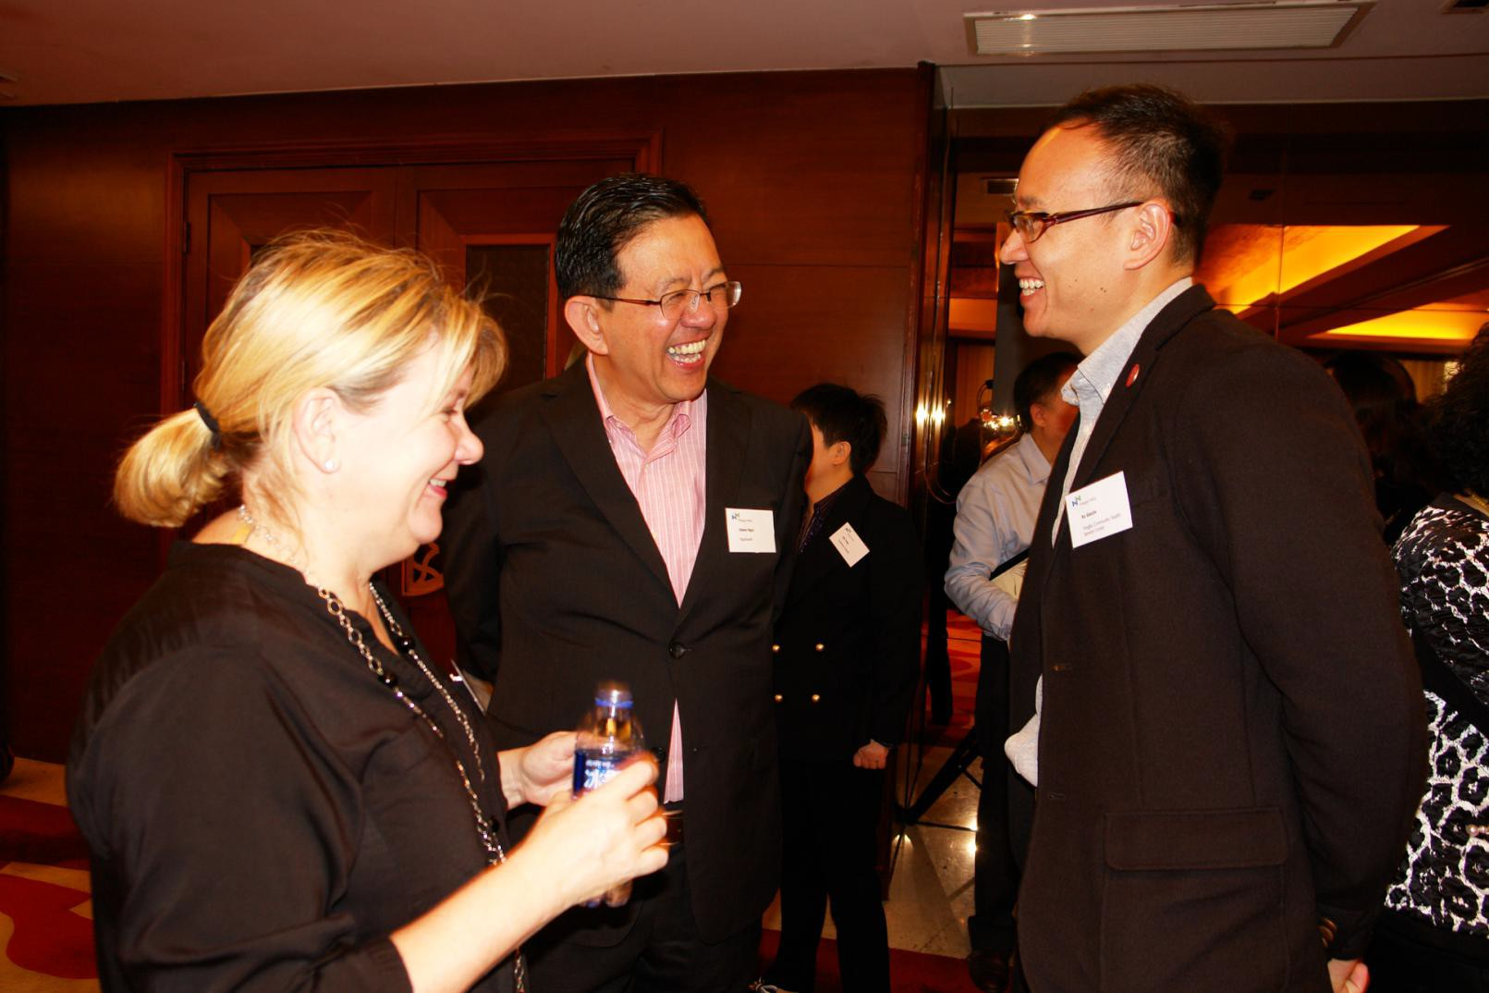
15.Marketing events in 2018-2020
February 2020, Mr Edwin Ngoi visited Rotary Club and Sithar Coffee Factory in Myanmar to promote the“Coffee for Peace”project.
In December 2019 the opening ceremony of NHC Health International Innovation Center (Suzhou) Co. Ltd .
September 2-7, 2019, Singapore famous businessman, the honor of Goi Family, Founder of TYJ Group and Executive Chairman of GSH Corporation - Sam Goi, invited 15 Goi brothers to visit TYJ factory, GSH Corporate Office, Sutera Harbour Hotel at Sabah and Sabah Mantanani Island.
In July 2019, Mr Edwin Ngoi participated in the Centennial Celebration of Rotary Club of Manila.
In May 2019, Prof. Salvador Aceves, Senior Vice President of Regis University, visited Suzhou and Shanghai to achieve strategic cooperation.
12-13 November 2018，a Sino-Finnish conference on smart cities, health care and elderly care was held in Suzhou. A press release was released on LinkedIn and some other media platforms
October, Mr. Edwin Ngoi was in the U.S. for nearly a month, visiting a number of hospitals and partners to explore opportunities of cooperation in the China market.
24-27 May 2018, the medical school of University of San Fransisco convened a conference that explored MNCs' strategy evolutions in China in the new era.
In May 2018 Haaga-Helia University of Applied Sciences came to Shanghai to meet with prospective partners.
22-25 April 2018 Mr Edwin Ngoi went to Vietnam for a charity event of Rotary International and Roots of Peace.

Slide 18

16.Founder and CEO Personal profile
Edwin Ngoi is a serial entrepreneur with rich experience in the fields of healthcare, sports and education. He is Founder and CEO of NHC Health International Innovation Center (Suzhou) Co.Ltd, NHC Capital (Shanghai) Co. Ltd. and Venture E (Shanghai) Co. Ltd. He is a member of the Shanghai Singapore Business Association in Shanghai and also a member of the International Education Expert Council of Haaga-Helia University of Applied Sciences in Finland. He enjoys working in philantrophy projects and is a member of the Rotary International. Prior to this, he held senior management positions at multinational companies such as Teradyne Singapore, BHP Lysaght Taiwan and China (Carrier, Whirlpool, Sara Lee and Lion Nathan China) and Singapore Tee Yih Jia (Baoding) Dairy Food. He holds an EMBA from the University of San Francisco, an MBA from the University of Texas at Arlington, and a BBA in MIS from Idaho State University.

Slide 19
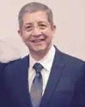
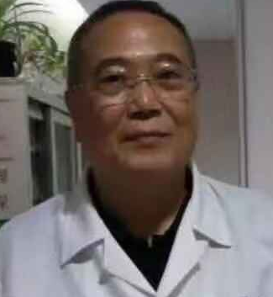
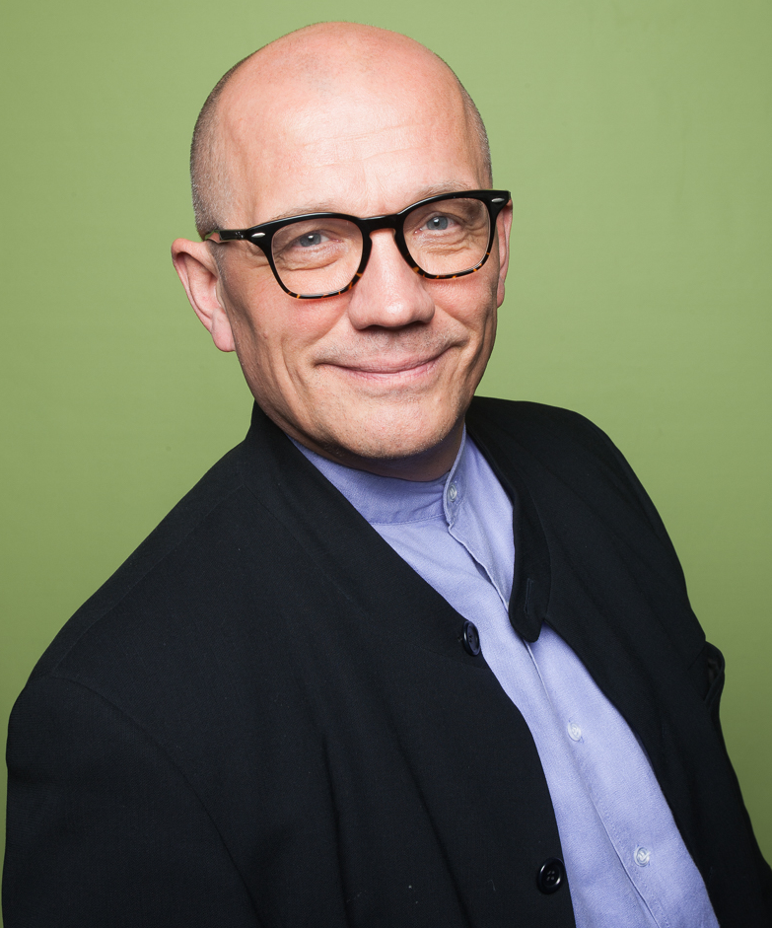
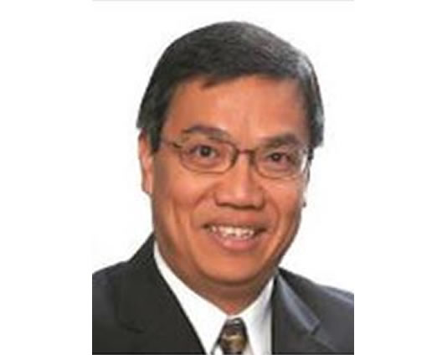
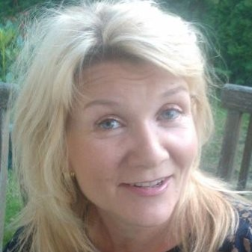
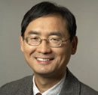
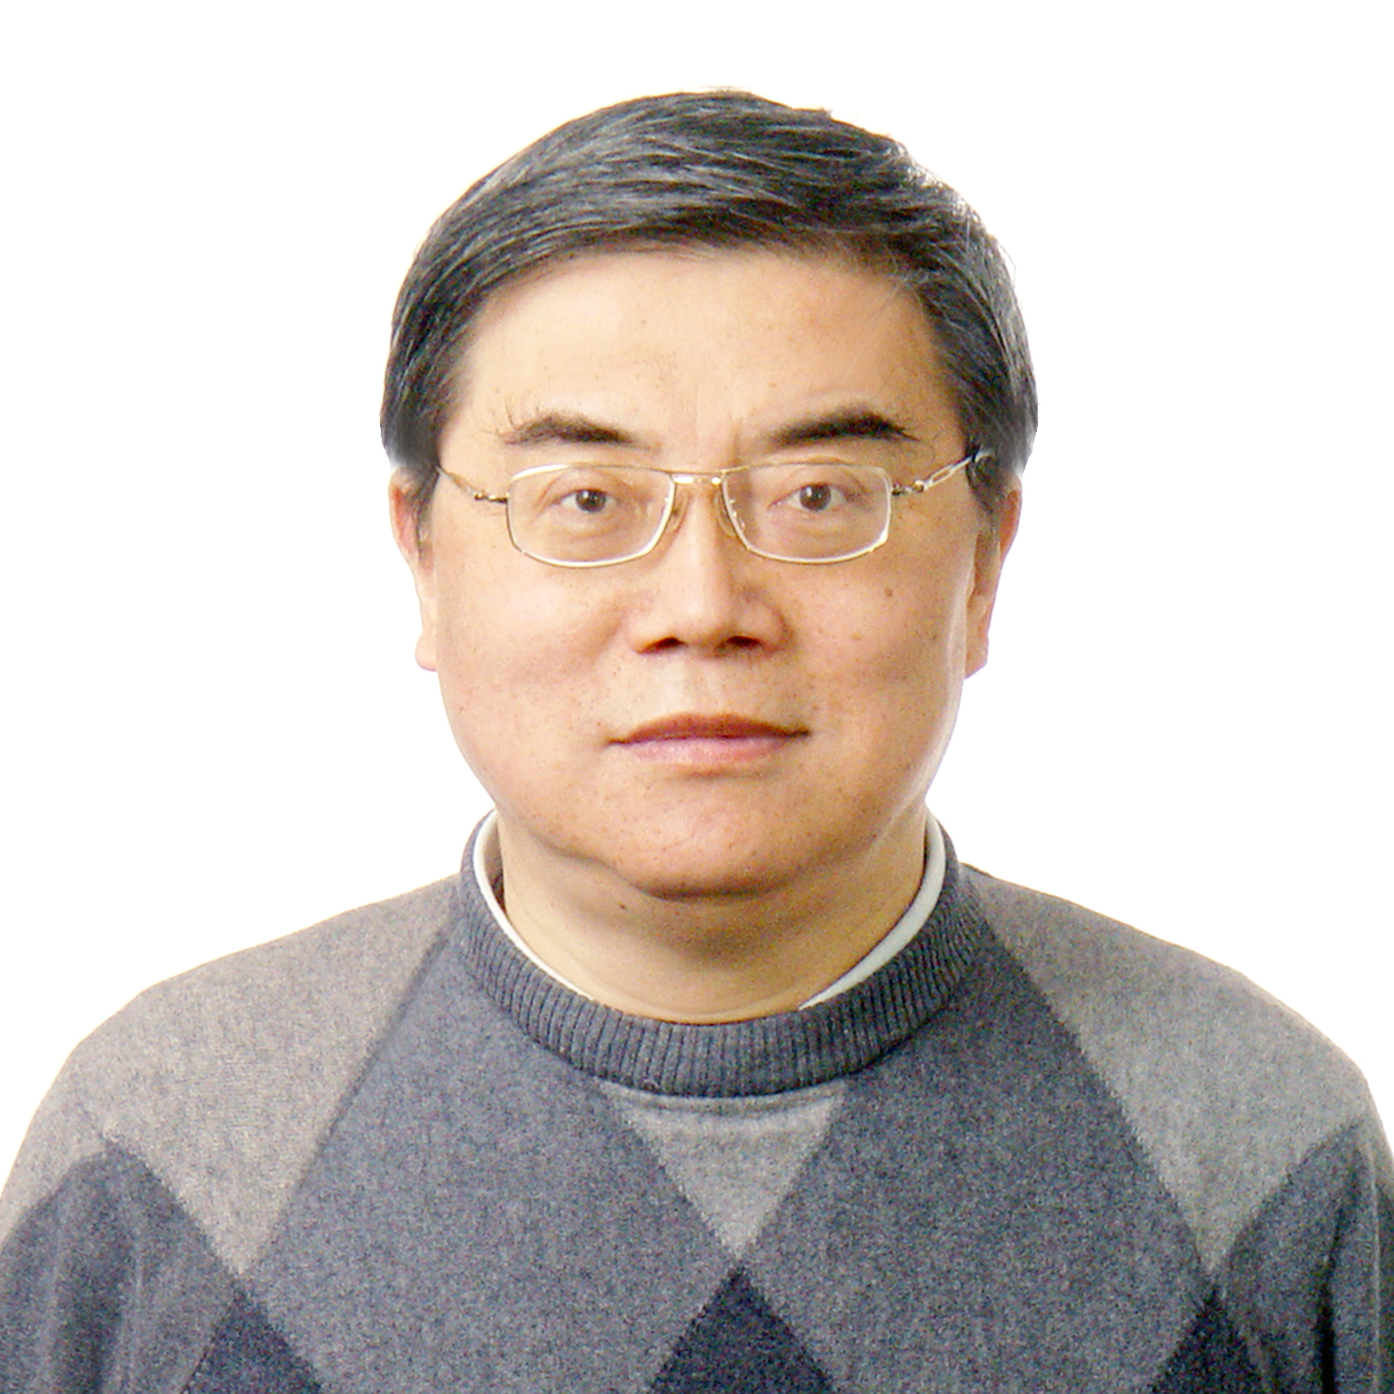
17.Advisors (part)
Salvador Aceves, Senior Vice-president and CFO at Regis University, USA. Formerly he was Vice-Provost with Fordham University and Vice-Provost with the University of San Francisco.
Tseng Cheng Hui, founder and former CEO of United World Chinese Bank, Former Vice-President of the Shanghai Ruidong Hospital.
MBA of Taiwan University and Master of Law of Chinese Culture University.
Pasi Halmari, Haaga-Helia University of Applied Sciences, has over three decades of experiences of higher education in Finland and elsewhere.
Dr. Ngoi Sing Shang, a renowned Consultant General Surgeon and Consultant Laparoscopic Surgeon at Gleneagle Hospital and Mount Elizabeth Hospital in Singapore, where he has his private practice.
Roger Chen, Professor in Strategy, University of San Francisco, USA.
He has advised Intel, Caterpillar, Tyco Electronics, etc. He holds a PhD in Strategy form the University of Texas at Dallas.
Tiina Laiho, Head of services and comms at CLIC Innovation Ltd & Innoboost Manager of Haaga-Helia University of Applied Sciences.
Li Naihe, Chief Data Scientist of NHC Sports. He's an associate professor at Shanghai Jiaotong University and an expert on big data and AI

Slide 20
18.Contact us
Edwin Ngoi
Founder / CEO
NHC BioTech Center
NHC Health International Innovation Center (Suzhou) Co., Ltd.
Email: edwinngoi@NHChealth.cn
Website：www.nhcBioTech.cn
Email: edwinngoi@nhchealth.cn
Floor 17, Dao Valley, No. 500, Shui
Xiu Road, Wujiang District, Suzhou 215200
Tel：0512-63168716 0512-63168711

