Slide 1


NHC Education Center
May 2020
Business Plan

Slide 2
1. Summary
Contents
Our office allocation and future needs
Finnacial forecast
13. Fund raising
NHC Education Center: Roadmap
NHC Education Center: Core products and services
2+2 Bachelor Program
EMBA
EDP
Consulting Service
Lab8 Project
Big Data
NICCAP
Exit strategy
Our partners
Our partners and customers (part)
17. Marketing events in 2018-2020
18.Founder and CEO Personal profile
19. Advisors (part)
20. Contact us

Slide 3
Historically China attaches much importance to education and education is one of the most active areas of spending for an average Chinese household. To meet the Chinese people's growing demand for education, we believe that educational programs from advanced nations such as Finland, the US and Singapore have a big potential in China, particularly when they are adapted to the individual needs of Chinese.
Summary
Market background
Introducing educational programs from Finland and other countries to China and localize it to meet the needs of the Chinese people. NHC Education Center strives to play an active role in it.
Our mission
About us
We boast an international perspective and strive to be a bridge that connects excellent international education resources with China's domestic needs to benefit the Chinese people.
NHC Education Center will corperate with well-known universities in the US and Finland to carry out 2+2 Bachelor, EMBA and EDP Programs.
We have the most experienced teaching faculty and mentors from the world's leading research and teaching institutions. We invite Chinese companies to go to the US and Finland to inspect advanced local management systems, delve into the efficient management models of major companies, learn their advanced and mature management concepts, and thus improve their overall business knowhow and management standards.
3

Slide 4
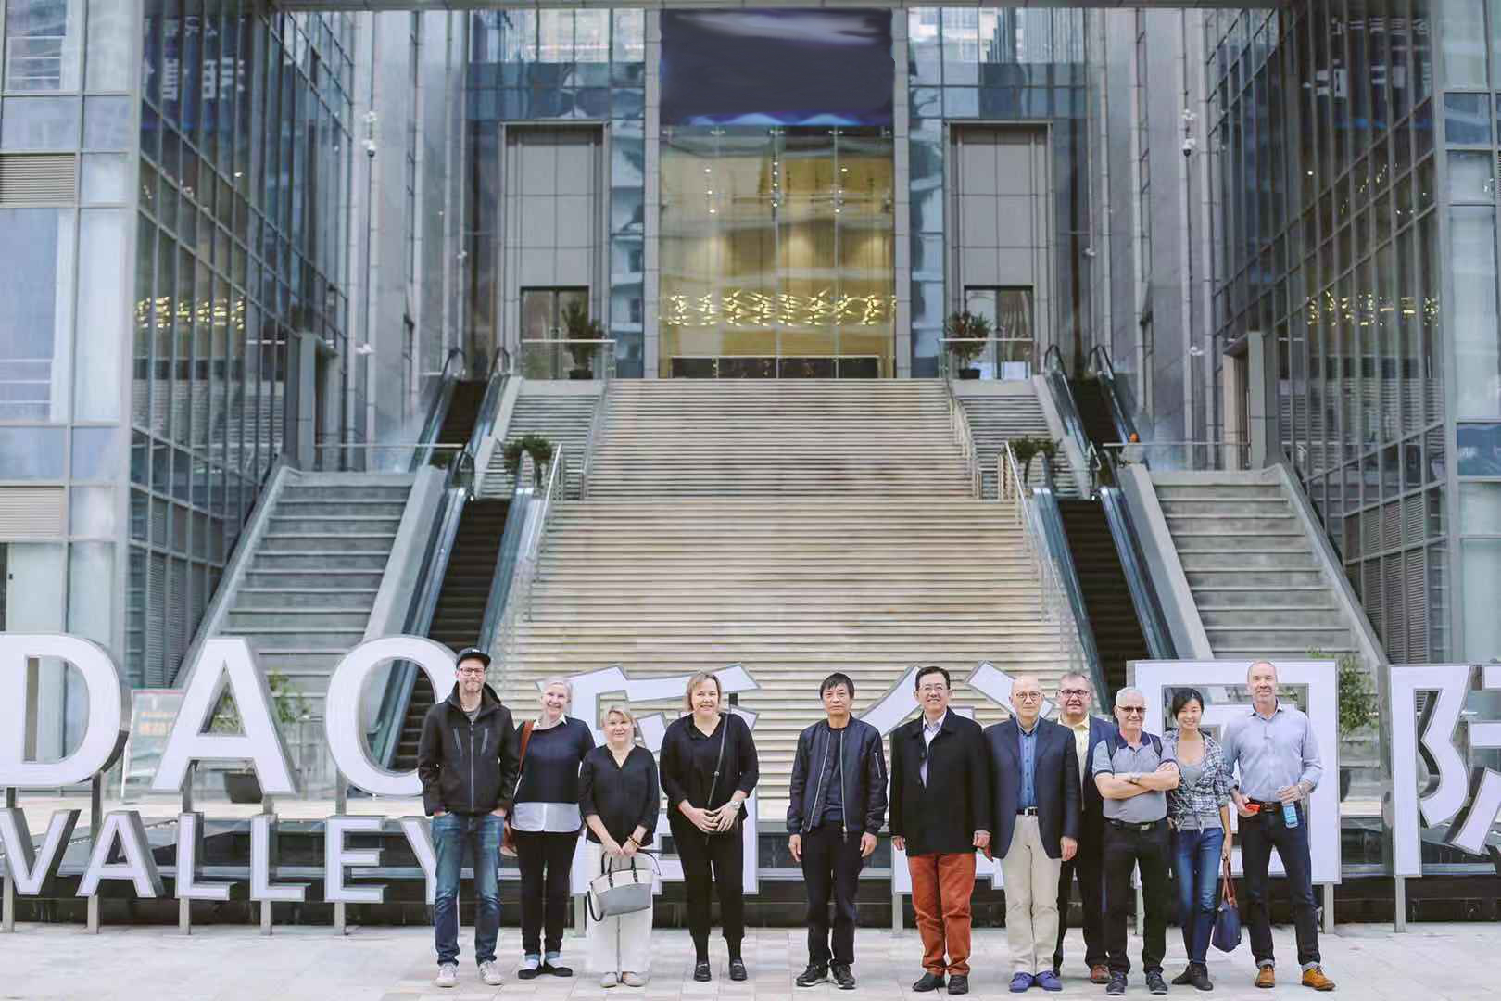
NHC Education Center: Our roadmap
Today
2020-2021
2022 and beyond
Established strategic collaboration and partnerships with Finland’s best winter sports management professionals and trainers
Establish a sports management center in Suzhou with the key offering:
Finnish science and technology and management talents provide training for Chinese youth
EMBA education in sports management to train Chinese talent in management of sports events and related economic activities
NHC Education Center as industry standard in management and education
Continue to innovate and create additional offerings such as:
2+2 Bachelor Program
EDP
VR/AR/MR Lab
Utilize 5G, AI, AR, Big data into education
NHC Sports posing with the Finnish partners

Slide 5
NHC Education Center： Core products and services
2+2 Bachelor Program
EMBA
EDP
Consulting Service
VR/AR/MR Lab
Haaga-Helia University of Applied Sciences's Lab 8 Suzhou & Big Data Center
5

Slide 6
2+2 Bachelor Program - Finnish Foundation Module
2+2 Bachelor Program
Foundation Module Project
In December 2019, Suzhou Industrial Park Insitiution of Vocational Technology and Haaga-Helia University of Applied Sciences in Finland signed a 2+2 cooperation memorandum, according to which, after completing 2 years of studies at IVT, students can directly apply for further studies in Haaga-Helia University of Applied Sciences in Finland to complete their undergraduate studies.
According to the MOU, IVT students need to take interviews organized by the school instead of taking expensive IELTS, when applying for Bachelors degree from Haaga-Helia University of Applied Sciences.
Foundation Module means students need to study for 3-12 months before entering the actual degree program
Once students have earned all credits for the foundation course, they are guaranteed entry into the degree program
Students will receive comprehensive personal guidance and assistance to ensure success
Some foundation courses are conducted remotely online, which makes the learning process more flexible
Diploma courses are completed at the leading universities in Finland
A quality degree provides an excellent opportunity for students to find work in Finland and other European countries and build a successful career
In China and have some essential training in spoken English, they can basically pass the Finnish school interview. This is absolutely good news for IVT students who want to studyAs long as IVT students pass the CET-4 abroad!

Slide 7
EMBA
The EMBA program of Haaga-Helia University of Applied Science in Finland lasts 18 months and offers 16 main courses, including Operations Management, Marketing Management, Human Resources Management, Strategic Management, Financial Management, and Organizational Behavior.
Most courses are taught by professors from Hagaa-Helia University in Finland in cooperation with a few local Chinese professors.
Focus on corporate innovation, closely integrate theory and practice, open up students' international horizons, and improve their management standards and capabilities.

Slide 8
EDP
Module | Class time
Balanced Score Card | Two days
Marketing | Two days
Competition Analysis | Two days
Leadership, Innovation and Development Strategies | Two days
Demand Estimation and Forecast | Two days
Entrepreneurship, Internal Entrepreneurship and Innovation | Two days
Human Resource Management and Development | Two days
Service Excellence | Two days

Slide 9
Consulting Center
Data Science&Data Analysis
VR lab
Business Consulting
Balanced Score Card & Financial Consulting

Slide 10
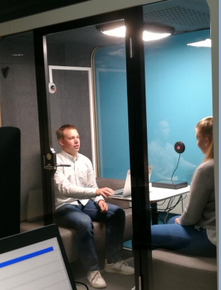


Haaga-Helia University of Applied Sciences's Lab 8 Suzhou
Service Experience Lab
These projects are already in operation in Finland, but are being introduced to China.
Applications of AR/VR/MR in sports events
SalesLab
buyer-seller interaction analysis)
eComLab
e-commerce analytics
Time | Target
Q2, 2020 | Set up R&D infrastructure in Suzhou: Fitting LAB8 functions & equipment to existing premises. Showroom capability
Q3, 2020 | Pilots with client company: Piloting Augmented Reality, Virtual Reality & Mixed Reality, Emotion AI, Facial Expression Analyses, Eye-tracking, Galvanic Skin Response, Semantic analyses, Speech related analyses
Q4, 2020 | Scale up: Extending RDI co-operation

Slide 11


Haaga-Helia Project: Big Data-Big Business
The purpose of Finland's big data project (2017-2019) is to find market opportunities and space through the collection and analysis of big data in the B2B market, and then set up relevant entrepreneurial projects in a targeted manner.
The implementation of this project relies on a multidisciplinary team: big data researchers, marketing and innovation talent, quantity and quantitative analysts, empirical analysts, and more.
Project Beneifts / output：
This project will improve the level of big data application analysis and help entrepreneurs find new business opportunities in the B2B market.
Help companies improve their sales strategies and sales channels, save costs and improve efficiency.
Status: This project has been operating in Finland for two and a half years, and has about ten strategic partners from universities and research institutions in Finland, Belgium and Germany, thanks to ample working capital provided by TEKES of Finland.
6

Slide 12


Haaga-Helia: NICCAP - Nordic Innovative Company Creation Acceleration Program
NICCAP:
An innovation curriculum that facilitates accelerated international growth for newly established start-ups by providing networks, contacts, resources and skills,
Comprises of three consecutive multidisciplinary and inter-generational hackathons and idea camps that mix students from the participating countries / organizations with the purpose of creating new cross-border companies and expanding the boundary of the innovation ecosystem,
NICCAP:
An innovation curriculum that facilitates accelerated international growth for newly established start-ups by providing networks, contacts, resources and skills,
Comprises of three consecutive multidisciplinary and inter-generational hackathons and idea camps that mix students from the participating countries / organizations with the purpose of creating new cross-border companies and expanding the boundary of the innovation ecosystem,
Project aims:
850 students are exposed to entrepreneurship and challenges in the silver, green and blue economies;
6 new cross-border companies with global potential will be created;
15 existing early stage startups are supported within the program;
6 joint demo days for ecosystem partners are organized during the program;
6 joint hackathon challenges are co-created with ecosystem partners;
Concrete road map with responsibilities and annual schedules for ecosystem engagement is created.

Slide 13
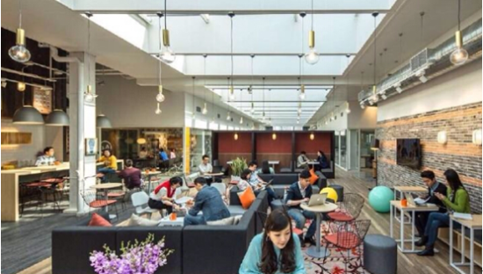
Our office allocation and future needs
Expecting exponential expansion of the operation, the Center will in the near future need 1,000 sqm of office space ：
  NHC Education with its games and events management, IT and marketing
  Haaga-Helia University of Applied Science
  Conference rooms of varied sizes, which includes a multi-functional center that is similiar in size and functions to the big lecturing halls of business schools.

Slide 14
Financial forecast（Million yuan）
Project | 2021 | 2022 | 2023
2+2Bachelor Program |  | 2 | 4
Foundation Module |  | 3 | 6
EMBA |  | 5 | 10
EDP | 5 | 5 | 10
Total sales | 5 | 15 | 30
PAT(2 0%) | 1 | 3 | 6
Cumulative PAT | 1 | 4 | 10
14

Slide 15

Fund Raising
Investment | S$ 4M RMB 20M
No. of investors | 20
Each Unit | S$100，000
Fund | Innovative Education Fund
15

Slide 16
Investment Stategy
Exit Stategy
3+2 years, including 3 years investment period and 2-year exit period
List the project as Innovative Education Project in Singapore
Sell the company at premium to the listed health care company
List the company at the STIB (Shanghai Exchange's new Science and Technology Innovation Board)
16

Slide 17



Our partners
Haaga-Helia is a strongly business orientated university of applied sciences in Finland. Through education, research and development, it prepares professionals for business and services, putting emphasis on the principle of co-operation, entrepreneurship, innovation and internationality. In Finland Haaga-Helia operates an innovation centre with the support of Nokia and other major Finnish companies. Haaga-Helia plans to install its first overseas R&D Innovation center in China, ie., in NIIC in Suzhou.
Established in 1877, Regis University is consistently ranked as a Top Tier Western University by U.S. News & World Report. Regis stresses on the importance of critical thinking and having a global perspective in its pedagogy. Its university has renowned IT faculties and R&D backgrounds, and plan to play an active role in NIIC and have its Regis R&D Innovation Centre.
University of San Francisco offers 17 undergraduate and 9 postgraduate majors, and currently more than 8,000 students from 75 countries are studying here. The University of San Francisco is the representative of American professional development universities. Its undergraduate education is famous for its entrepreneurial spirit. It is known as the cradle of Chinese chairmen and has cultivated many well-known entrepreneurs such as theCEO of Intel Corporation and the founder of Adobe.
17

Slide 18
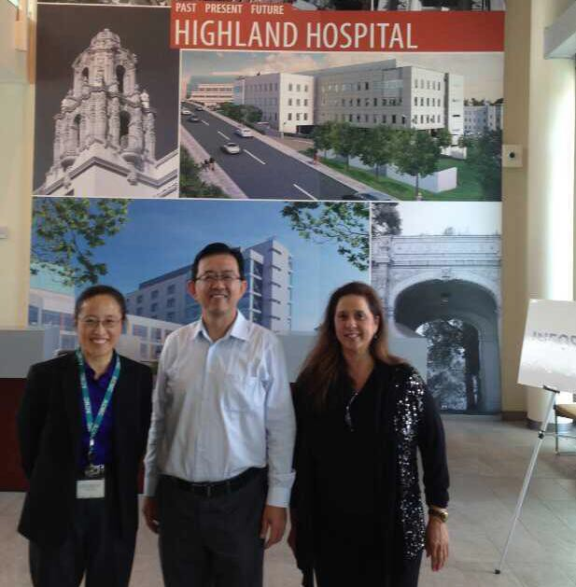

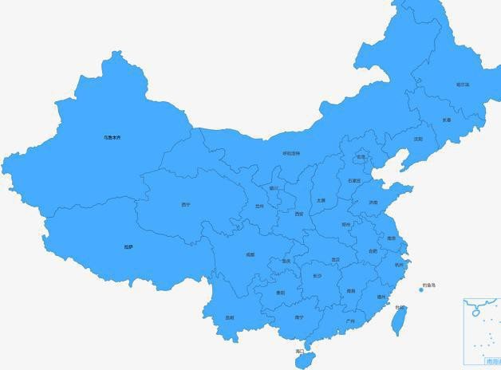
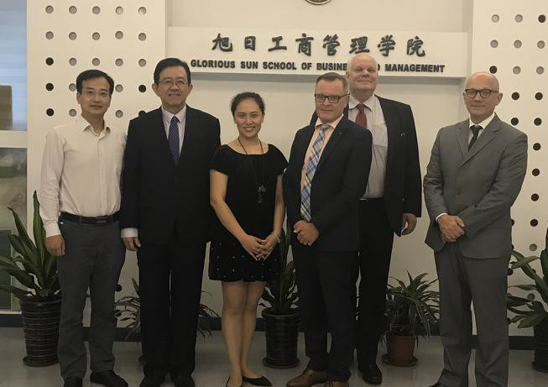


Our Partners and Customers
Suzhou Wujiang District Ministry of Health
Suzhou No.9 Hospital
Wuxi No.8 Hospital
Wuxi No.3 Hospital
Customer
Lan Zhou Military General Hospital
ents
Corporate customers
Longrich Group
WCI Investment Group
Nu Skin China
NHD China
Nivea China
Fed Express China
Overseas Hospital Partner
Academic Institution Partners
Singapore Mount Elizabeth Hospital
Haaga-Hela University of Applied Science
Regis University
Singapore Gleneagle Hospital
University of San Francisco

Slide 19
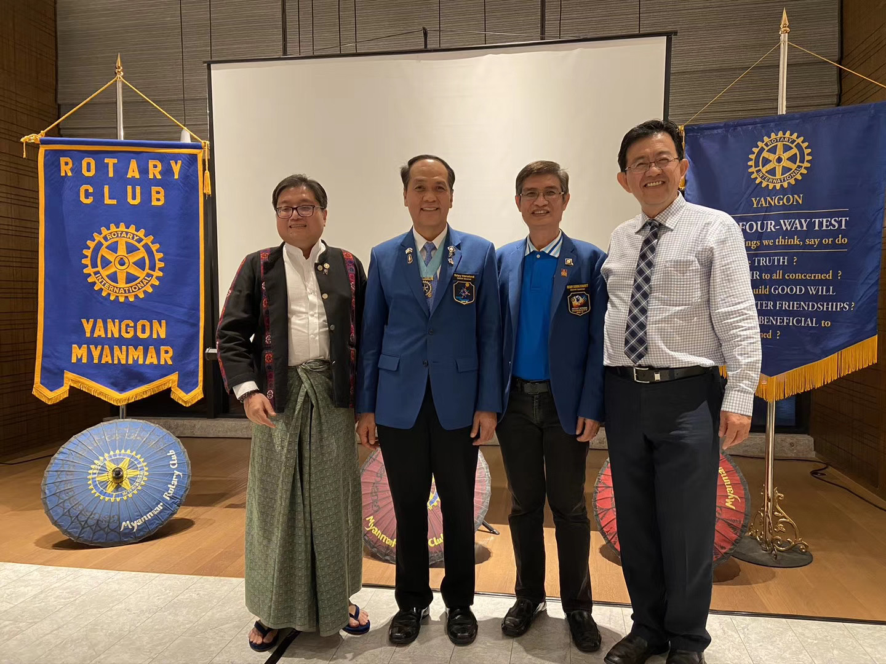
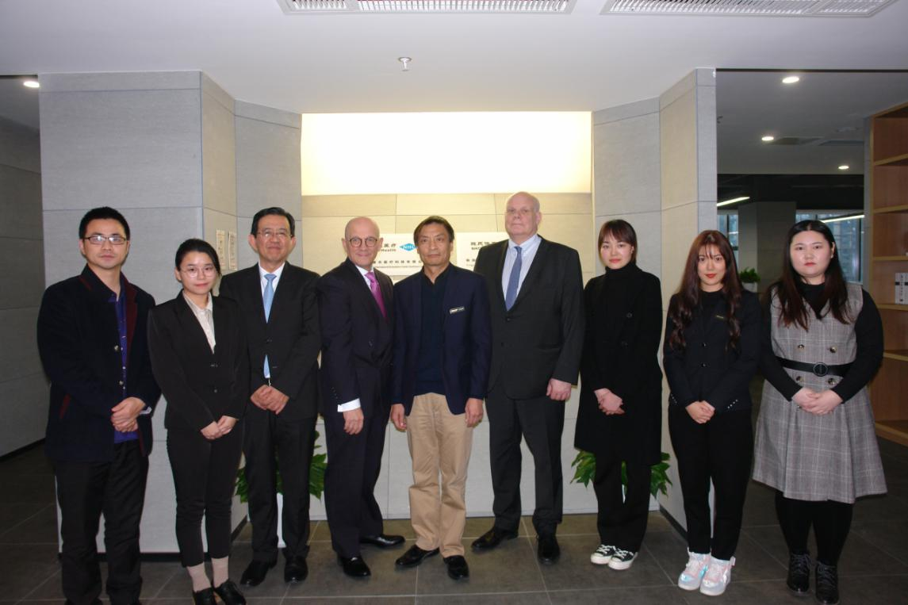
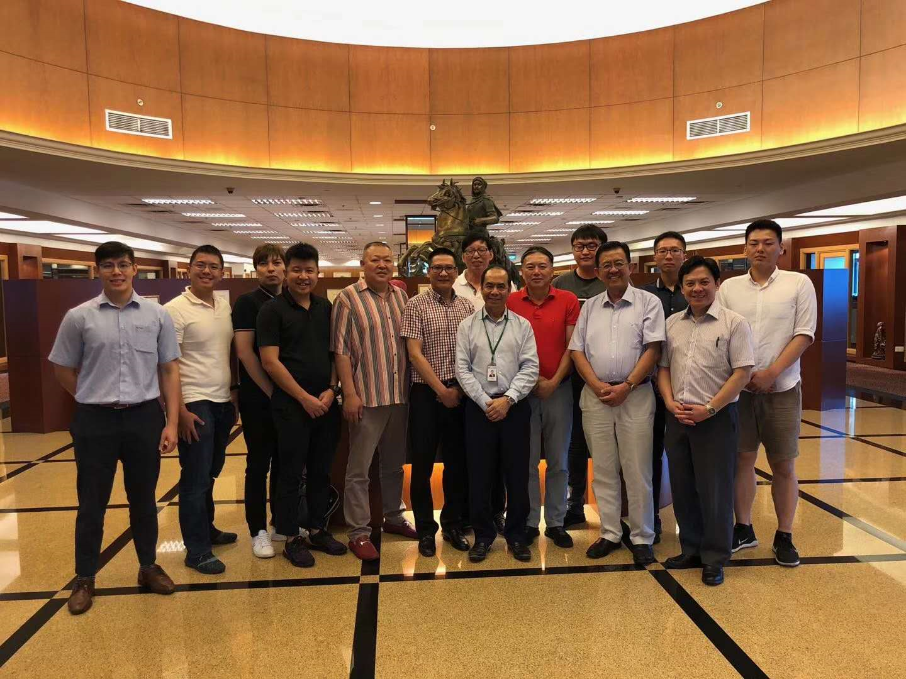
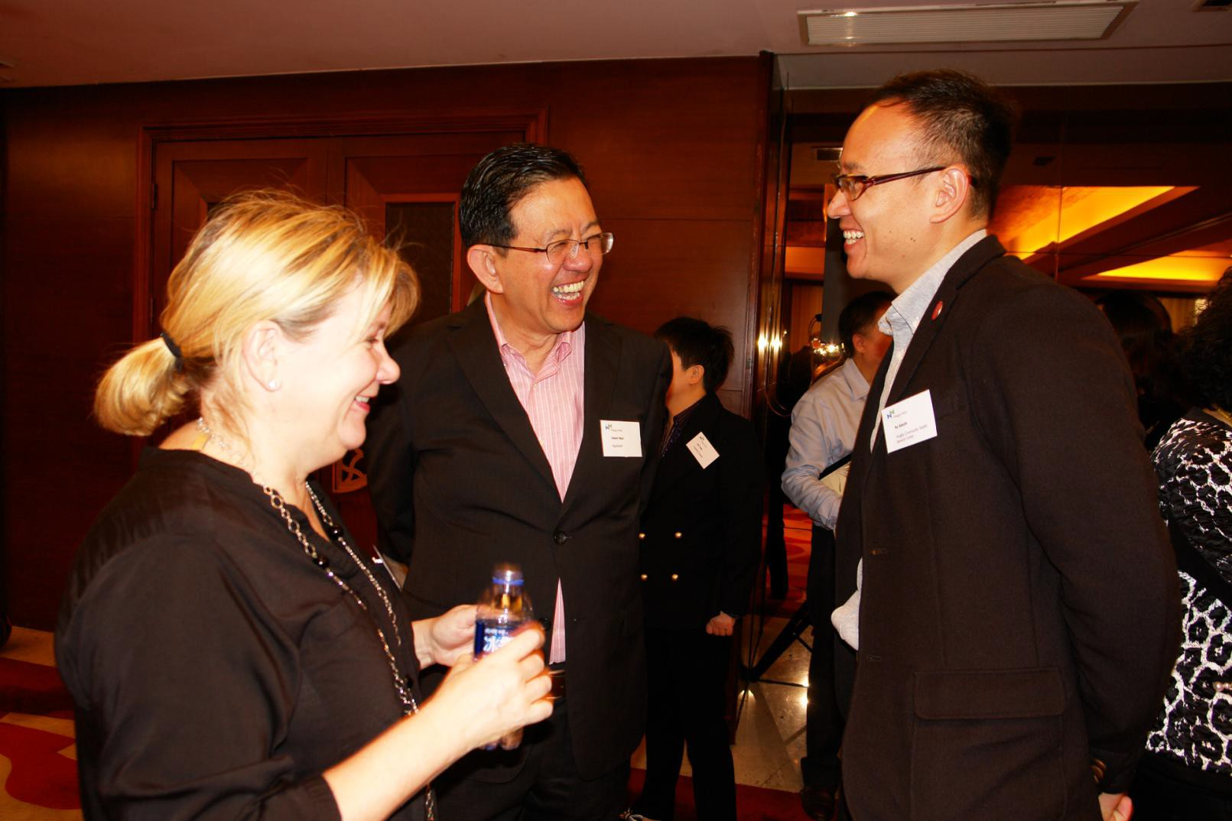
Marketing events in 2018-2020
February 2020, Mr Edwin Ngoi visited Rotary Club and Sithar Coffee Factory in Myanmar to promote the“Coffee for Peace”project.
In December 2019 the opening ceremony of NHC Health International Innovation Center (Suzhou) Co. Ltd .
September 2-7, 2019, Singapore famous businessman, the honor of Goi Family, Founder of TYJ Group and Executive Chairman of GSH Corporation - Sam Goi, invited 15 Goi brothers to visit TYJ factory, GSH Corporate Office, Sutera Harbour Hotel at Sabah and Sabah Mantanani Island.
In July 2019, Mr Edwin Ngoi participated in the Centennial Celebration of Rotary Club of Manila.
In May 2019, Prof. Salvador Aceves, Senior Vice President of Regis University, visited Suzhou and Shanghai to achieve strategic cooperation.
12-13 November 2018，a Sino-Finnish conference on smart cities, health care and elderly care was held in Suzhou. A press release was released on LinkedIn and some other media platforms
October, Mr. Edwin Ngoi was in the U.S. for nearly a month, visiting a number of hospitals and partners to explore opportunities of cooperation in the China market.
24-27 May 2018, the medical school of University of San Fransisco convened a conference that explored MNCs' strategy evolutions in China in the new era.
In May 2018 Haaga-Helia University of Applied Sciences came to Shanghai to meet with prospective partners.
22-25 April 2018 Mr Edwin Ngoi went to Vietnam for a charity event of Rotary International and Roots of Peace.

Slide 20

Founder and CEO Personal profile
Edwin Ngoi is a serial entrepreneur with rich experience in the fields of healthcare, sports and education. He is Founder and CEO of NHC Health International Innovation Center (Suzhou) Co.Ltd, NHC Capital (Shanghai) Co. Ltd. and Venture E (Shanghai) Co. Ltd. He is a member of the Shanghai Singapore Business Association in Shanghai and also a member of the International Education Expert Council of Haaga-Helia University of Applied Sciences in Finland. He enjoys working in philantrophy projects and is a member of the Rotary International. Prior to this, he held senior management positions at multinational companies such as Teradyne Singapore, BHP Lysaght Taiwan and China (Carrier, Whirlpool, Sara Lee and Lion Nathan China) and Singapore Tee Yih Jia (Baoding) Dairy Food. He holds an EMBA from the University of San Francisco, an MBA from the University of Texas at Arlington, and a BBA in MIS from Idaho State University.
13

Slide 21
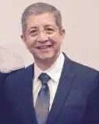
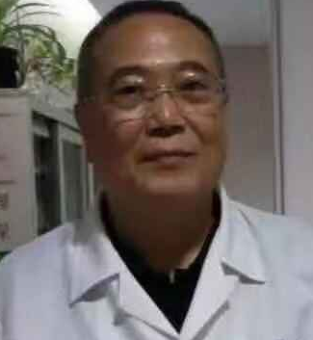
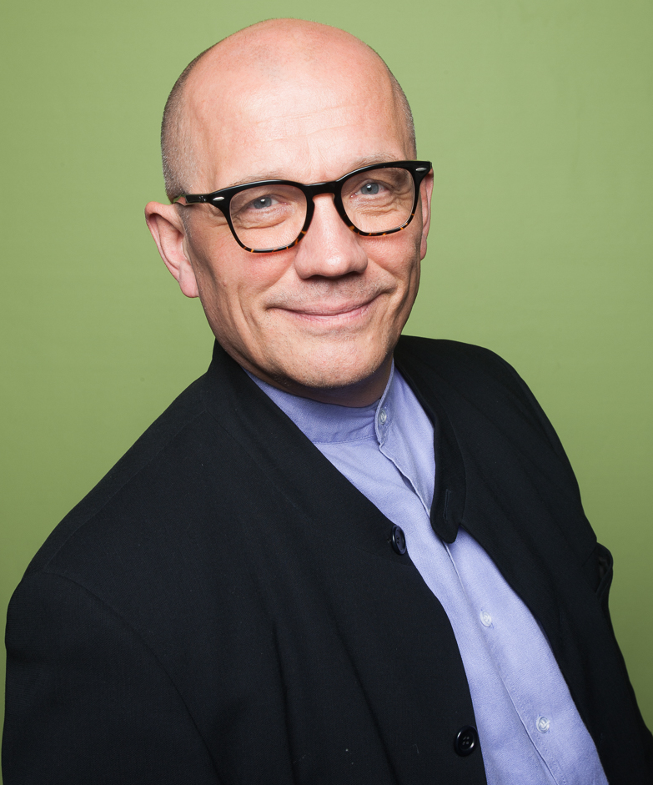
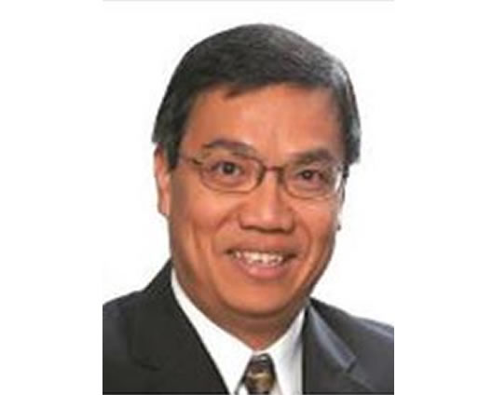
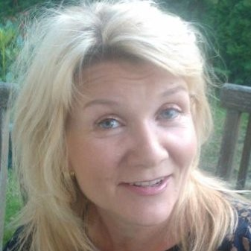
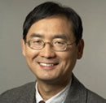
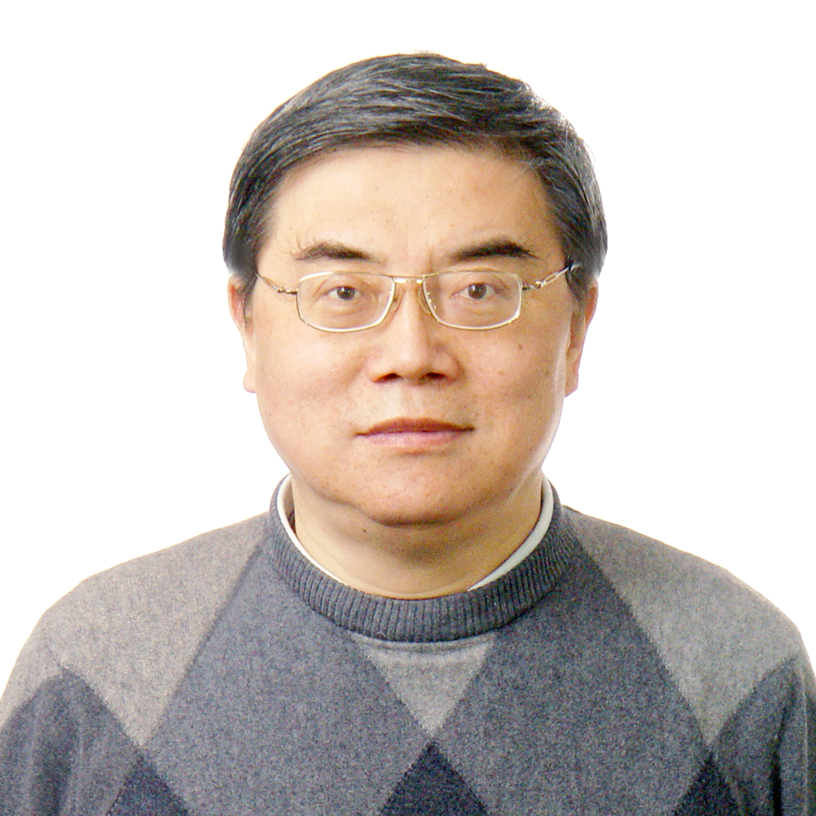
Advisors (part)
Salvador Aceves, Senior Vice-president and CFO at Regis University, USA. Formerly he was Vice-Provost with Fordham University and Vice-Provost with the University of San Francisco.
Tseng Cheng Hui, founder and former CEO of United World Chinese Bank, Former Vice-President of the Shanghai Ruidong Hospital.
MBA of Taiwan University and Master of Law of Chinese Culture University.
Pasi Halmari, Haaga-Helia University of Applied Sciences, has over three decades of experiences of higher education in Finland and elsewhere.
Dr. Ngoi Sing Shang, a renowned Consultant General Surgeon and Consultant Laparoscopic Surgeon at Gleneagle Hospital and Mount Elizabeth Hospital in Singapore, where he has his private practice.
Roger Chen, Professor in Strategy, University of San Francisco, USA.
He has advised Intel, Caterpillar, Tyco Electronics, etc. He holds a PhD in Strategy form the University of Texas at Dallas.
Tiina Laiho, Head of services and comms at CLIC Innovation Ltd & Innoboost Manager of Haaga-Helia University of Applied Sciences.
Li Naihe, Chief Data Scientist of NHC Sports. He's an associate professor at Shanghai Jiaotong University and an expert on big data and AI

Slide 22
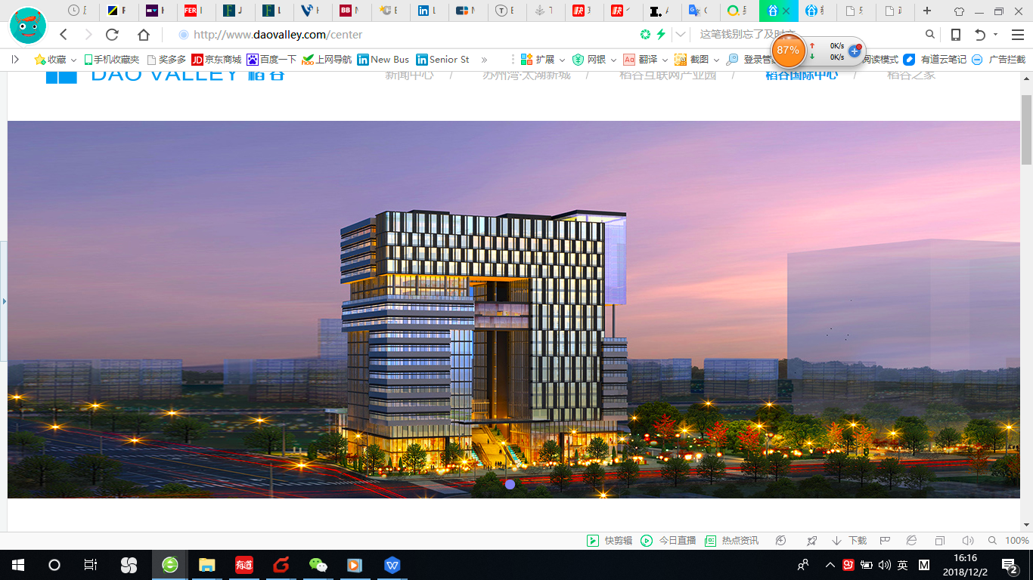
Contact us
Edwin Ngoi
Founder/CEO
NHC Education Center
NHC Health International Innovation Center (Suzhou) Co., Ltd.
Email: edwinngoi@NHChealth.cn
Website：www.nhceducation.cn
Email: edwinngoi@nhchealth.cn
Floor 17, Dao Valley, No. 500, Shui
Xiu Road, Wujiang District, Suzhou 215200
Tel：0512-63168716 0512-63168711

